Slide 1
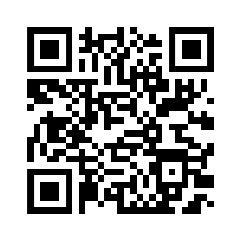
Fujifilm and the Ghost Language Project
https://github.com/nightbeacons/ghostlanguage

Slide 2
Case Study: FUJIFILM SonoSite and the Ghost Language Project
I ain't afraid of no ghost
Charles Jackson
BADCamp
October 2019

Slide 3
The Problem:
Hey! You Can't Show That Here!
but we need to show it Germany, Spain, and Bolivia!
(and it needs to work in Drupal 7 and Drupal 8)

Slide 4
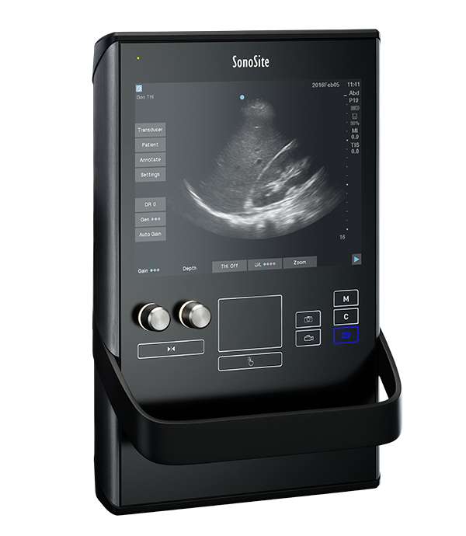
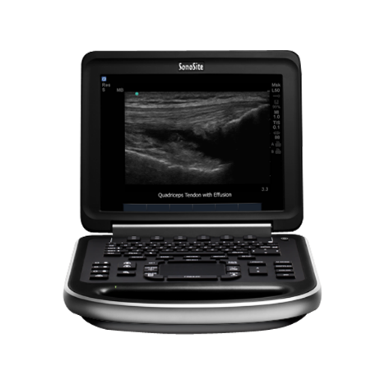
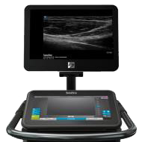
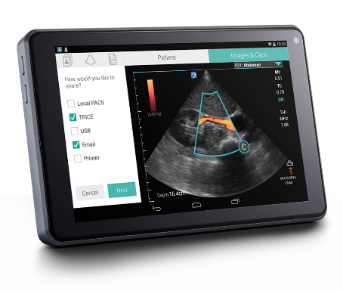
FUJIFILM SonoSite manufactures medical devices that are sold around the world.

Slide 5
But regulatory restrictions forbid SonoSite from publishing sales information about a device until it has been approved for sale in that country.
X
X

Slide 6
Drupal's ability to unpublish translated content often makes it a good choice for showing approved translations, while hiding the pending ones . . .
X
X

Slide 7
But wait
there's more . . .

Slide 8
As soon as Regulatory approval is received, the corresponding translation is set to a published state.
Regulatory approvals usually happen more quickly in Europe and Asia.
The approved translations are published weeks (or months) before the English-language (source) can be published.

Slide 9
So you just keep the English-language source unpublished until it's finally approved.
ummm . . . Right???

Slide 10
But when you unpublish a source document node,
all the child translations (which are part of the node) are also unpublished.

Slide 11
The Problem:
Restated:
How do we unpublish the parent (source)
without unpublishing the child translations?

Slide 12
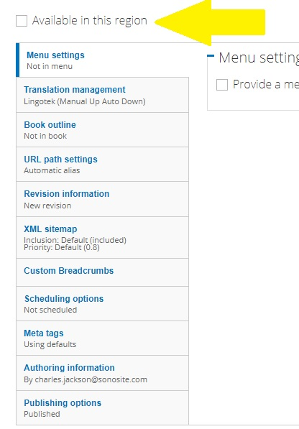
Solution #1
add another checkbox

Slide 13
Caused some problems:
Very confusing to content editors
Needed lot$ of cu$tom code ($$$)
Did not "play well" with other modules
Notes:
Confusing: We had two controls doing the same job.

Slide 14
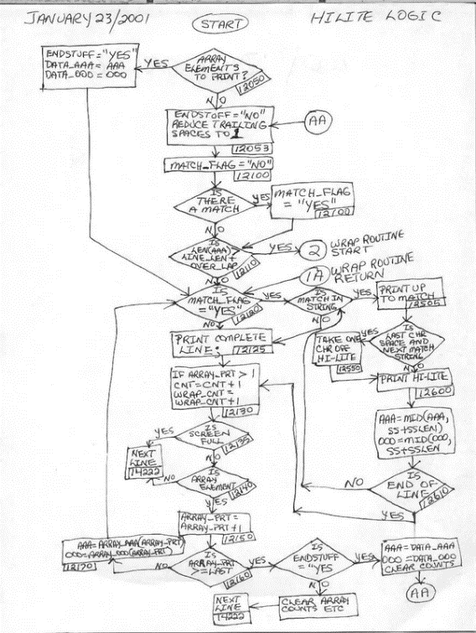
and more problems:
Views became more complex
Menus were problematic
HREFLANG tags needed help
Getting new developers up-to-speed
Not the Drupal Way

Slide 15
Solution #2
the Ghost Language
Create a hidden copy of the US-English site,
where all content is published.
From this copy, create the US site
as just another translation.

Slide 16
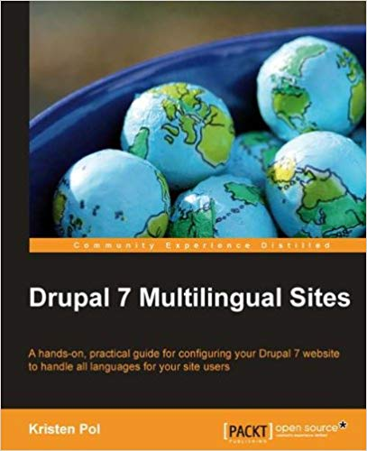
Checking with the Experts:
So we ran the idea past Kristen Pol and Aimee Hannaford, the translation experts at Hook42 (who, quite literally, wrote the books on Multilingual Drupal sites)

Slide 17
Checking with the Experts:
. . . as well as with two of the leading Drupal translation firms (Lingotek and Smartling)
to get some honest feedback about this approach

Slide 19
The theory, they said, was sound.
. . . but it had never been done before

Slide 20
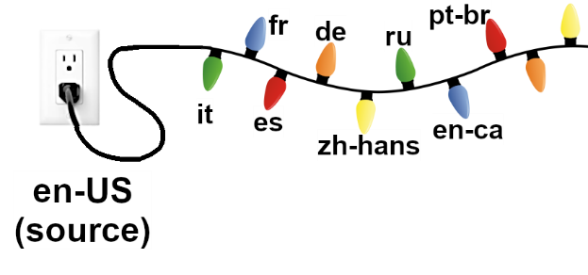
Without the Ghost
You can easily "turn off" any individual translation.
But if you "turn off" the source, ALL the lights go off.

Slide 21
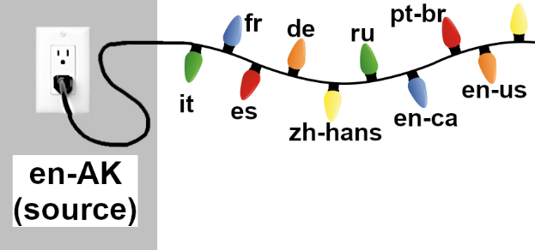
With Ghost
The (hidden) source remains published.
US-English (en-us) becomes just another translation,
but remains the default language.

Slide 22
With Ghost
And is translated (or copied) here.
All content is
created here.

Slide 23
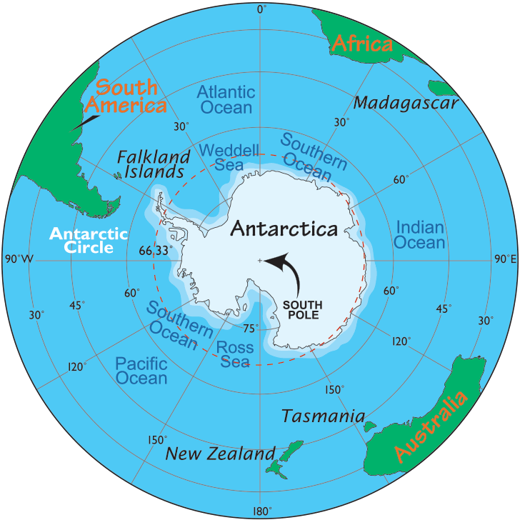
en-AK
en-AK is the language/country code
for Antarctic English.
It was selected to be the code for the
Ghost Language because it was not
likely to be needed for production content.
Notes:
English Creole was also considered

Slide 24
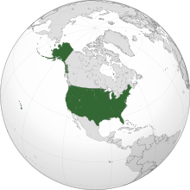
en-US
en-US is the language/country code
for US English.
It remains the default language.
(Note: The Source Language is not
the same as the Default Language!)
Notes:
Some translation modules assume that a site's Source Language is the same as its Default Language.

Slide 25
Building The Ghost
Overview:
Take a full dump of the database
Change the source en-US content to en-AK
Re-import the database
Copy all en-AK content to en-US
It's not as scary as it sounds…

Slide 26
MySQL and mysqldump
Details:
Take a full dump of the database (Keep a separate copy for backup)
mysqldump --opt sonosite > sonosite.sql

Slide 27
mysqldump
Details:
1a. Save backups of the tables you'll need
mysqldump --opt sonosite languages >
languages.sql
mysqldump --opt sonosite xmlsitemap >
xmlsitemap.sql
mysqldump --opt sonosite xmlsitemap_sitemap >
xmlsitemap_sitemap.sql
Notes:
You'll add these back into the DB later

Slide 28
sed - a very cool tool
Details:
2. Change the source en-US content to en-AK
sed 's/en-us/en-ak/g' sonosite.sql > ghost.sql
Notes:
Use 'sed' to do a search-and-replace on the database dump. The new DB file is called "ghost.sql"
Before running, check the DB for any "en-us" string that was not a language code. (Dumping to XML via mysqldump --xml and grep was a quick way to do this)

Slide 29
Drop All Tables
Details:
2a. Empty the database
mysqldump --add-drop-table \
--no-data sonosite \
| grep ^DROP | mysql sonosite
Notes:
A very handy way to delete every table from a database.

Slide 30
Import the Ghost
Details:
3. Re-import the database
mysql sonosite < ghost.sql
Notes:
And clear cache after doing this

Slide 31
Import Saved Tables
Details:
3a. Re-import the tables you saved in 1a.
(languages and xml sitemaps tables)
mysql sonosite < languages.sql
mysql sonosite < xmlsitemap.sql
mysql sonosite < xmlsitemap_sitemap.sql
Notes:
And clear cache after doing this

Slide 32
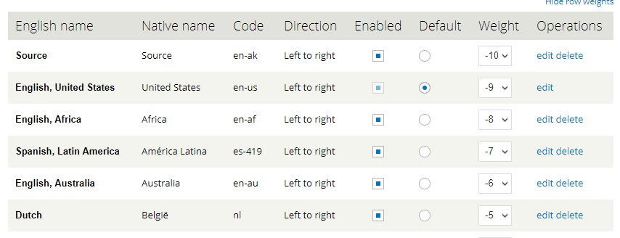
Define the Ghost
3b. In Drupal, add the custom language en-ak set the path prefix to source
and the Language Name to Source
Notes:
Be sure to enable the language, too!

Slide 33
No Prefix for en-us
Details:
3c. In MySQL, set the language prefix
to '' (an empty string) for en-us:
mysql> update languages set prefix=''
where language='en-us';
Notes:
Be sure to enable the language, too!

Slide 34
The Ghost and Lingotek
Lingotek expects to receive source
content that is tagged en-us, not en-ak.
Fix this by updating the Lingotek
language mapping table in MySQL:
mysql> update languages
set lingotek_locale='en_US'
where name='Source';
(when done, be sure to take a backup of the languages table!)
Notes:
Not documented -- but this is how to do it!

Slide 35
Translate to US-English
"Translate" all en-AK content to en-US
Originally, we used TMGMT
and wrote a pass-through
translator plugin that simply
copied en-ak content to en-us
It took 2-4 days to manually
translate the entire site.

Slide 36
TMGMT
We contacted Miro Dietiker, one of the creators of TMGMT, and asked if there a tmgmt drush command that might automate the process.
Miro suggested that a dedicated script that copied field-to-field would be a much better approach.
Notes:
Miro DEE-tih-kerr

Slide 37
GREAT
IDEA!
THANK YOU
MIRO

Slide 38
Copy Field-to-Field
So we generated a list of the fields that would be affected by an en-ak to en-us translation, and began building a script to do the copying.

Slide 39
Finding the Fields
We created a very simple Basic Page,
then took XML database dumps
before and after translation.
Comparing the two dumps quickly revealed the affected fields. (then repeat for each type)
See github.com/nightbeacons/Expecto_Patronum
Notes:
See the github repo for the XML database dump scripts and dircmp commands we used.

Slide 40
Field-to-Field Script
The rest was simple . . .
For every field in our list:
SELECT all rows WHERE language='en-ak'
Make a temporary copy of that row
Change the copy's language to 'en-us'
INSERT it into the DB
Notes:
Clear cache when done. The script was written to be re-runnable, and turned a 4-day job into a 5-minute job!

Slide 41
Cleaning Up
And a few minor tweaks to make it perfect:
UPDATE users SET language='en-us' WHERE language='en-ak';
UPDATE url_alias SET language='en-us' WHERE source regexp 'user' AND language='en-ak';
UPDATE entity_translation SET source='en-ak' WHERE language != 'en-ak';

Slide 42
Cleaning Up
Simplify Views
Enable blocks for en-us
Remove custom modules
Check DB for missed dependencies
Remove that checkbox
Notes:
mysqldump -xml to generate greppable content, then check for dependencies

Slide 43
Securing The Ghost
Details:
Add path_access and language_access modules. Make sure everyone can see en-us, but only admins and content creators can
access /source/*
Also, be sure robots.txt
disallows /source/
Notes:
And clear cache, of course. Note: path_access not available in D8

Slide 44
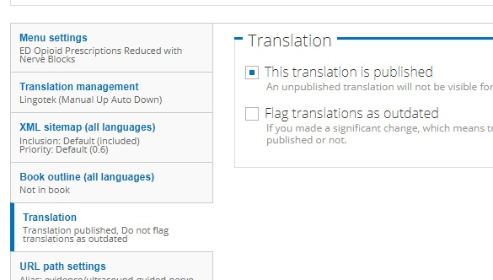
Using the Ghost
The Ghost worked well. It was now simple to enable and disable any translation.

Slide 45
Building on the Ghost
But with nine major product lines, 21 locales, and product availabilities that change by the week; keeping the sites current was still pretty challenging. Even with the Ghost.
Where can I talk about
the iViz product?
What products are
available in Brazil?
Which products can be mentioned
in which countries?

Slide 46
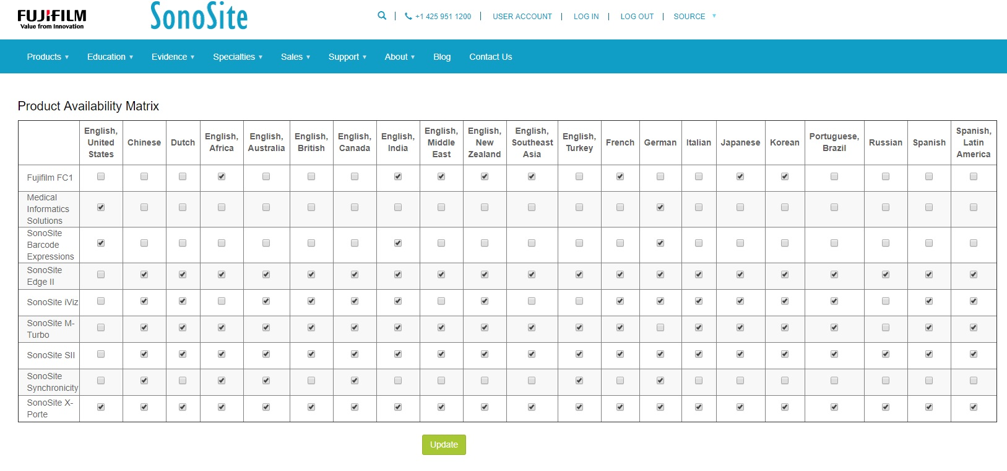
Product Control Panel
Notes:
We built a Product Control Panel, only visible to admins, that presented an overview of which products were available in which countries.
It suddenly became simple to answer those product availability questions.
The dashboard also lets you batch-update publication status. Click on the appropriate checkboxes and click Update.
For auditing purposes, we also added a tooltip, which quickly shows you when the page's translation status was changed, and by whom.

Slide 47
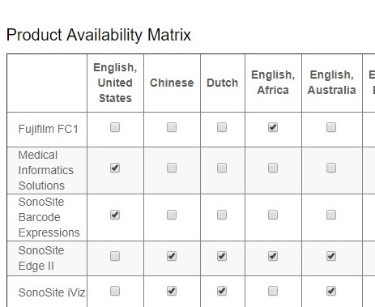
Product Control Panel
Notes:
A closer Look

Slide 48
Building on the Ghost
We need to write about our products in our blog posts and our Evidence pages.
But it's a nightmare to remember where each product reference occurred, and to edit each translation whenever a product's status changes.
- Never mention PQRS in Italy or Germany
- Today you can mention ABC in Canada and Japan
- You can't talk about XYZ in the US, Brazil, or China!

Slide 49
Building on the Ghost
And remove ABC references from all Korean pages
but I don't speak any Korean!

Slide 50
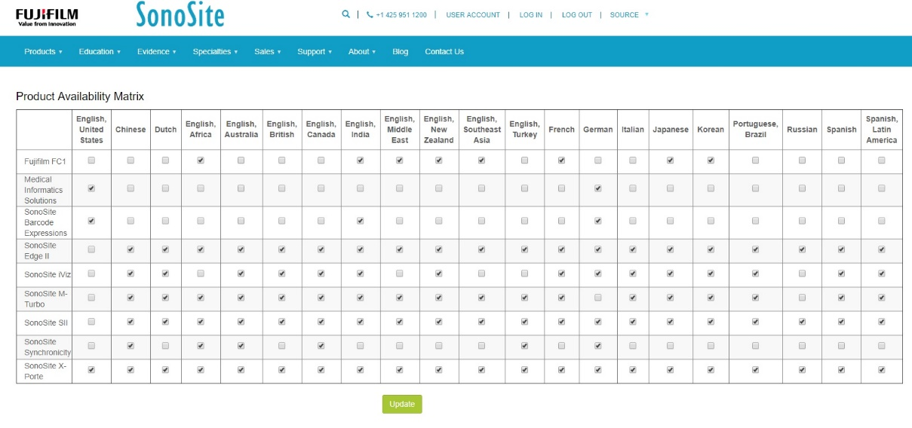
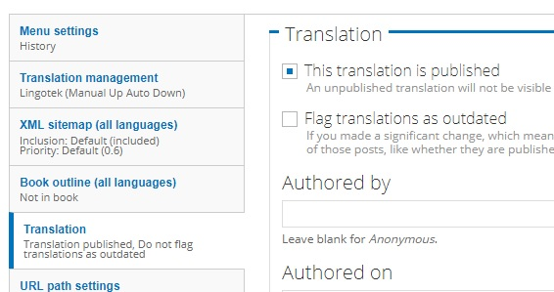
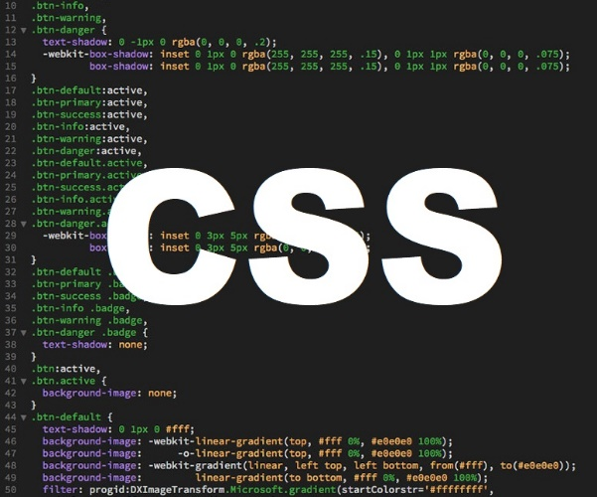
Expanding the Control Panel
Notes:
In addition to updating the publication status of each translation, we added code to generate a simple CSS stylesheet.
The stylesheet allowed writers to tag product-specific content. The content would either be displayed or hidden depending on the selected locale.

Slide 51
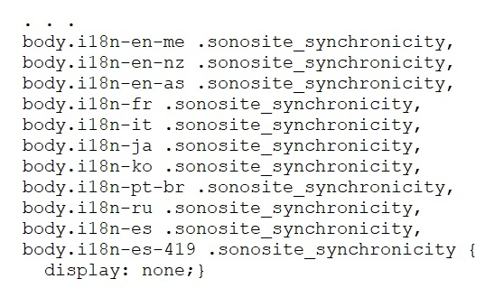
Generated CSS
Snippet of the generated CSS file

Slide 52
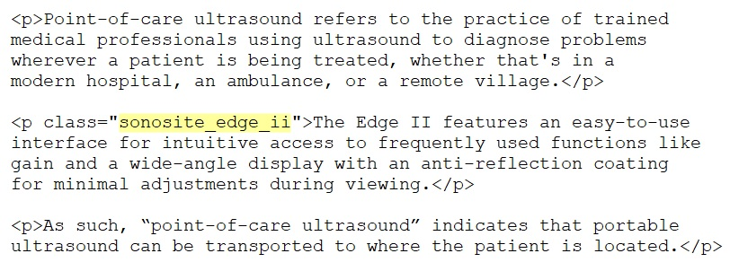
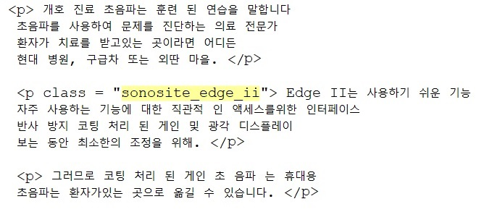
Use in Drupal
Original
Translated
Notes:
Some drawbacks to this technique:
(1) Translation costs are slightly higher, because we are paying for translations that a user might never see.
(2) Although humans cannot see it, search engines are able to index the undisplayed text.

Slide 53
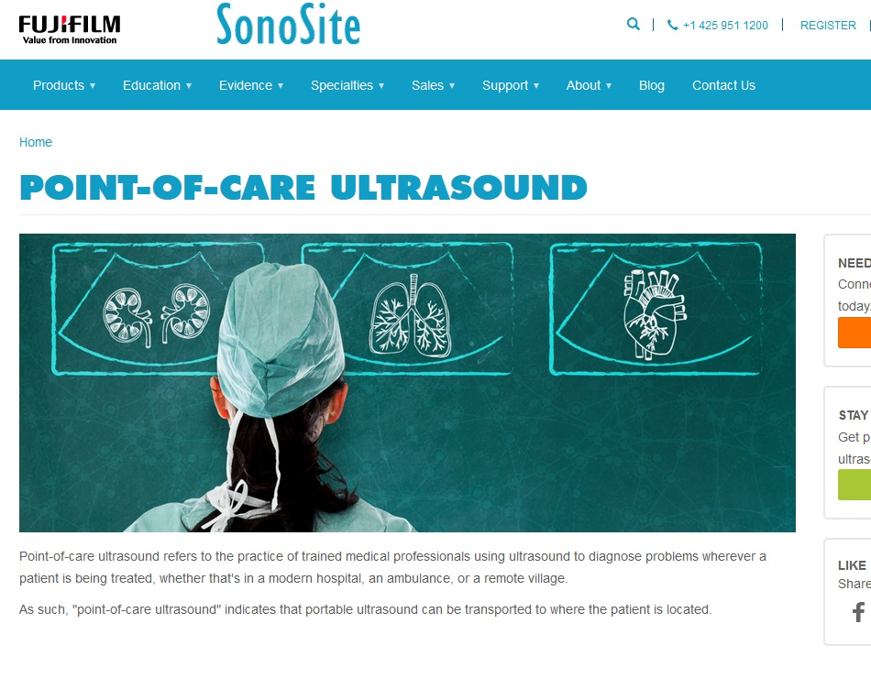
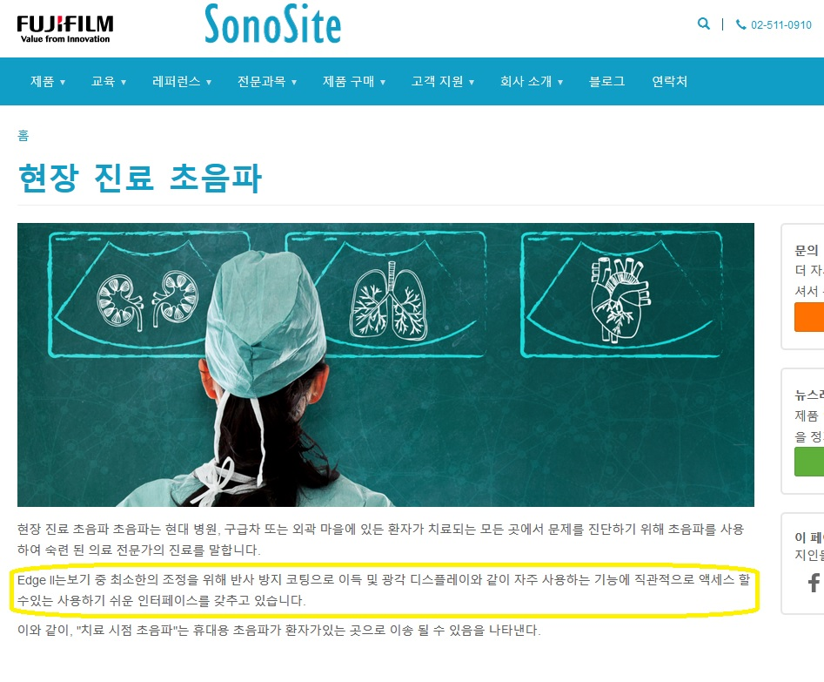
Use in Drupal
Translation with Edge II
CSS "turned off"
Translation with Edge II
CSS "turned on"
Notes:
Obviously, the CSS class can be used for any element.

Slide 54
Kristen Pol, Aimee Hannaford, and Adam Bergstein - Hook42
Miro Dietiker - TMGMT
Damon Logan - FUJIFILM SonoSite
Clark Fuller and the Engineering staff - Lingotek
Juan Luna, Gowoon Kim, and Adrian Cohn - Smartling
Tony Murrow - Little Island LLC

Slide 55
Fujifilm SonoSite is the global leader in
point-of-care ultrasound.
We operate a suite of Drupal-based
product sites, educational sites, and
web-based apps.

Slide 56
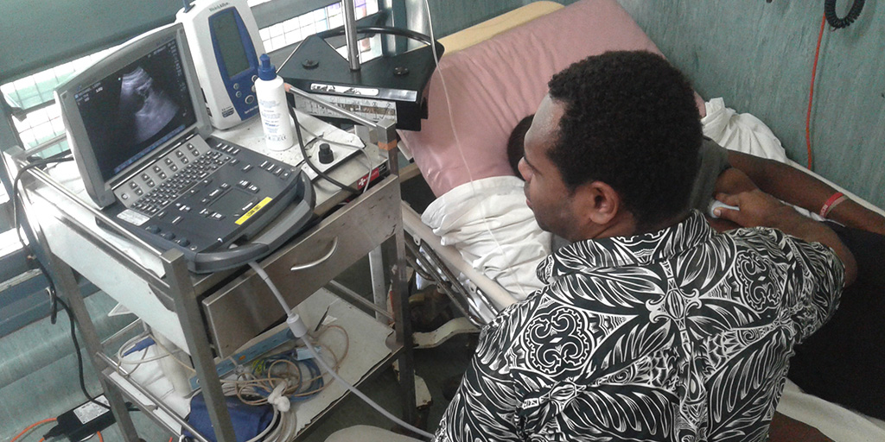
From the jungles of Panama to the mountains of Nepal, our Global Health Program helps bring portable ultrasound to patients and institutions that don't have access to medical imaging.

Slide 57
Questions?

Slide 58
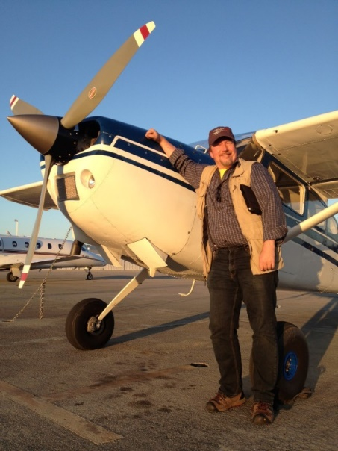
Charles Jackson
Charles.Jackson@fujifilm.com
Senior Web Manager
Fujifilm SonoSite
Since 1992, I’ve built enterprise web sites for Fortune 100 companies, government agencies, and small businesses.

